Slide 1
Chapter 8
Communicating with Customers

Slide 2
Learning Objectives
After completing this chapter, you should be able to:
• Explain how effective managers plan ways to incorporate a nutrition emphasis into their menus and
food-preparation procedures.
• Review examples of truth-in-menu concerns that must be addressed when menu descriptions are written.
• Describe elements in an organized system for ensuring the health of customers with food allergies.
• Explain concerns about the service of alcoholic beverages.

Slide 3
Customer Concerns about Nutrition
Nutrition Is a Trend

Slide 4
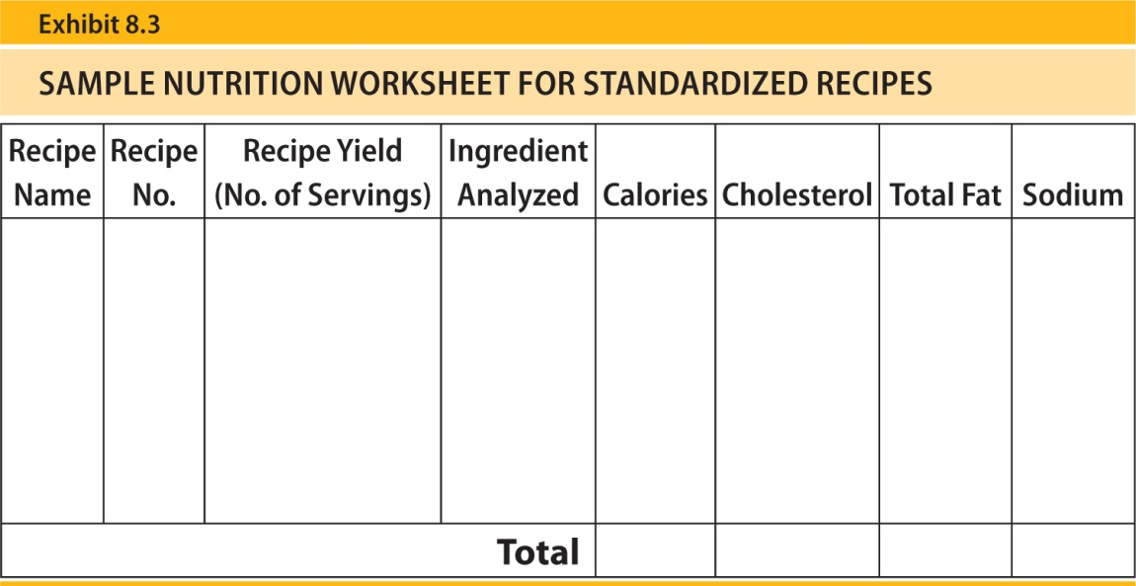
Planning for Nutrition Concerns
Menu Planning
Simple Changes
Nutritional Content of Recipes

Slide 5
Truth-in-Menu Concerns

Slide 6
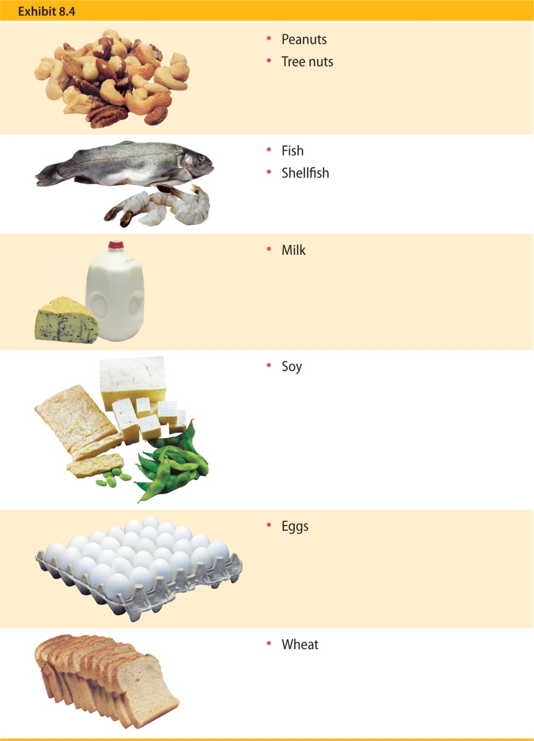
Allergies and the Menu
Basics of Food Allergies

Slide 7
Create a Management Plan
Reduce Liability
Consider Customer Ordering Procedures

Slide 8
More about the Manager’s Role
More about the Servers’ Role
More about the Chef’s Role

Slide 9
Responsible Service of Alcoholic Beverages
Alcoholic Beverages and the Body

Slide 10
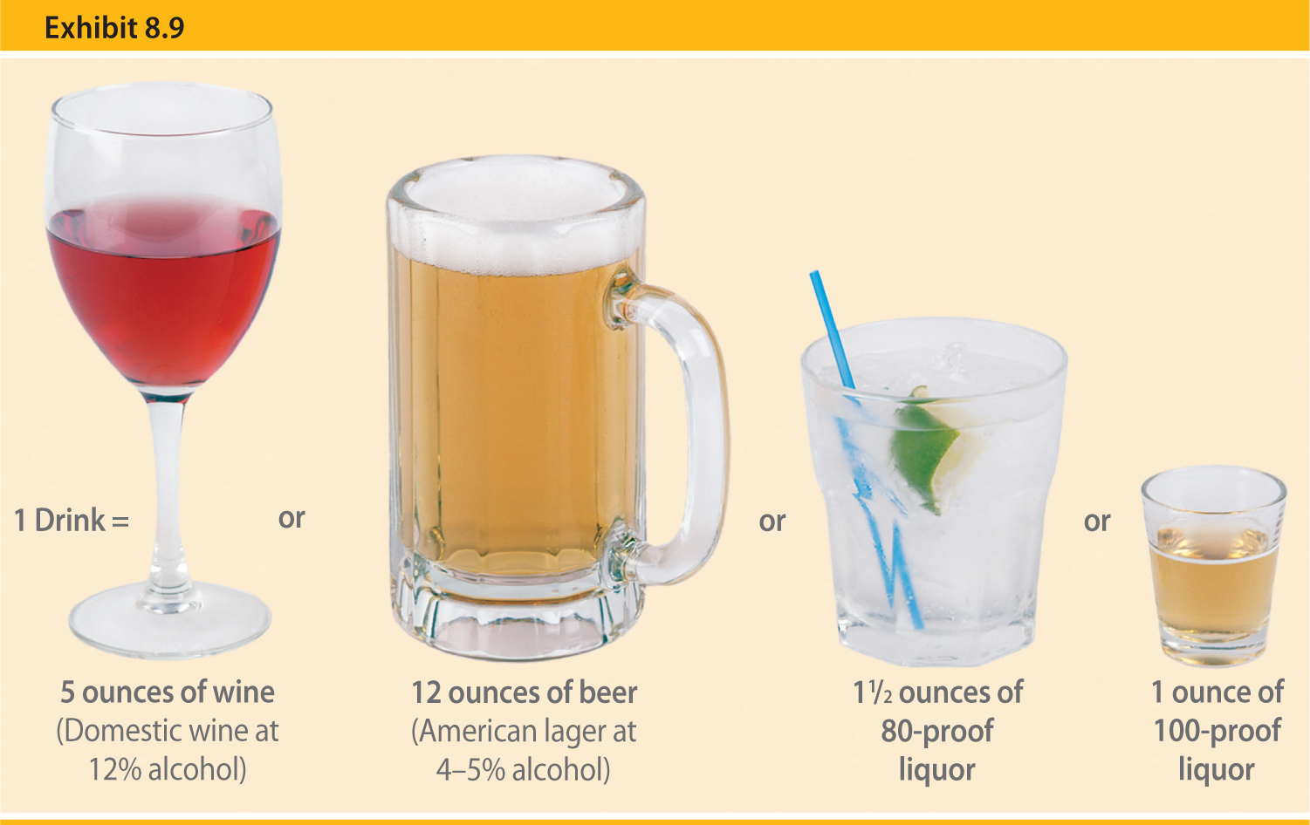
Determining the Level of Intoxication

Slide 11
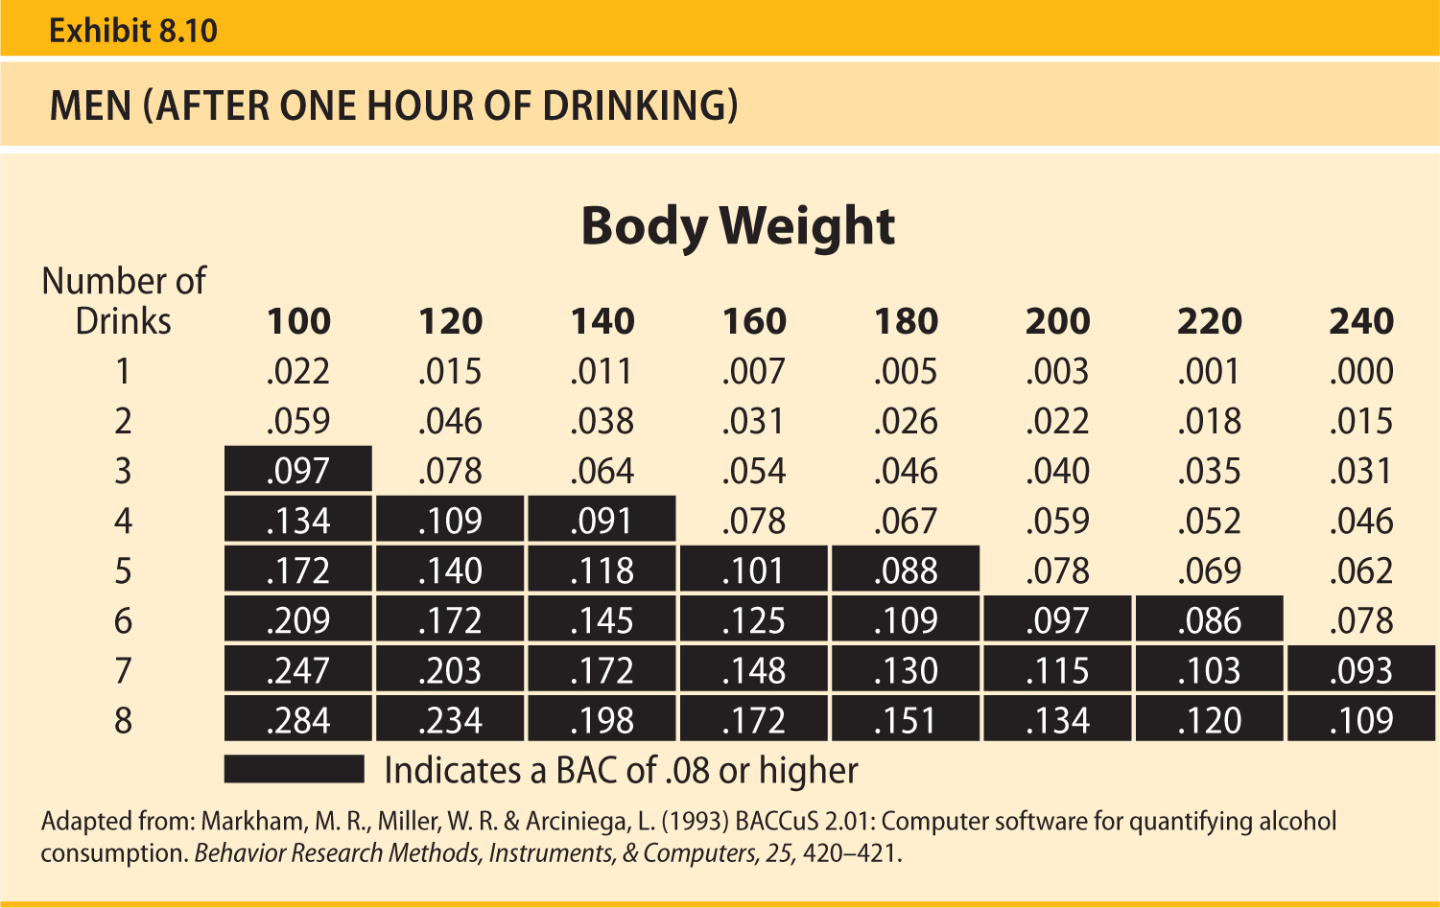

Slide 12
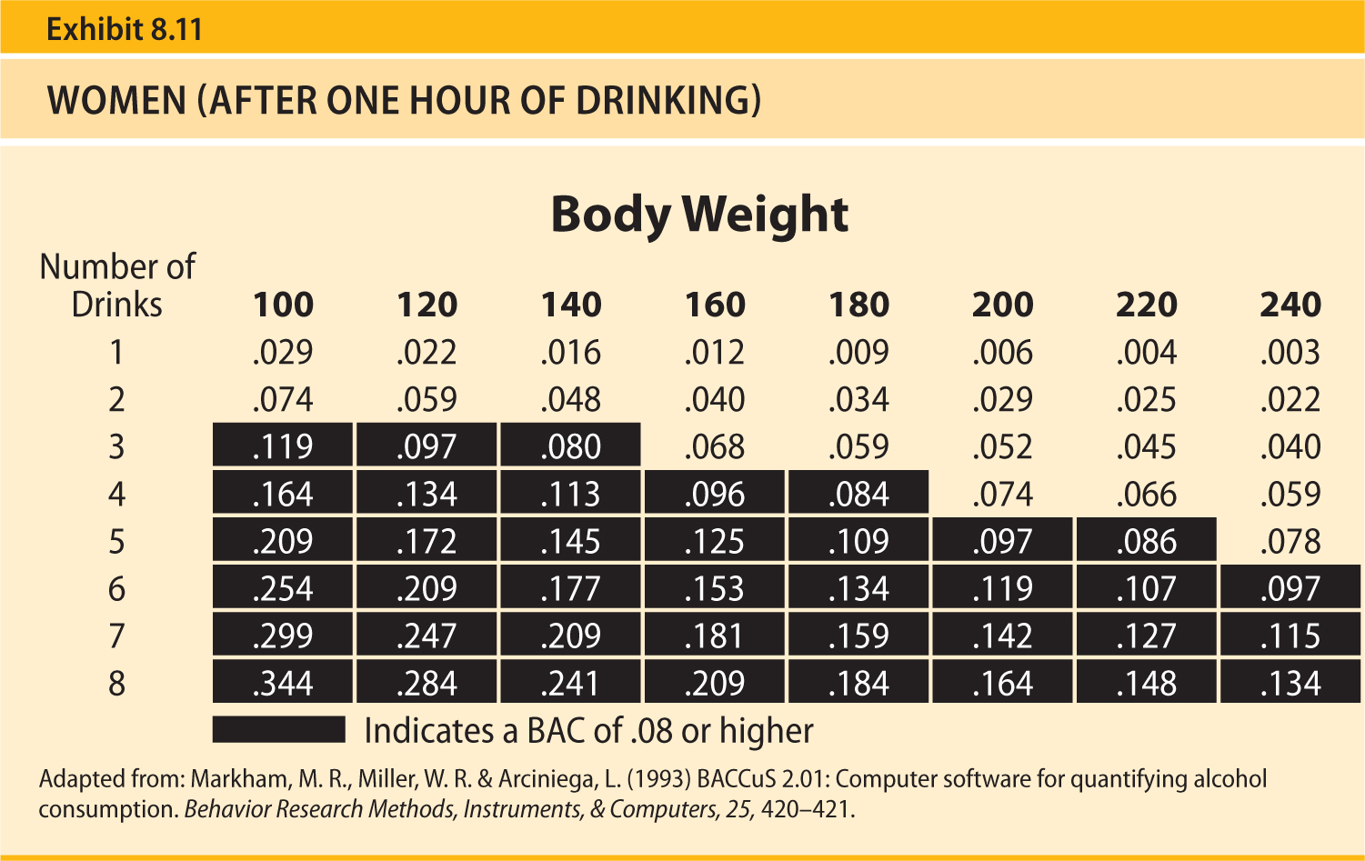

Slide 13
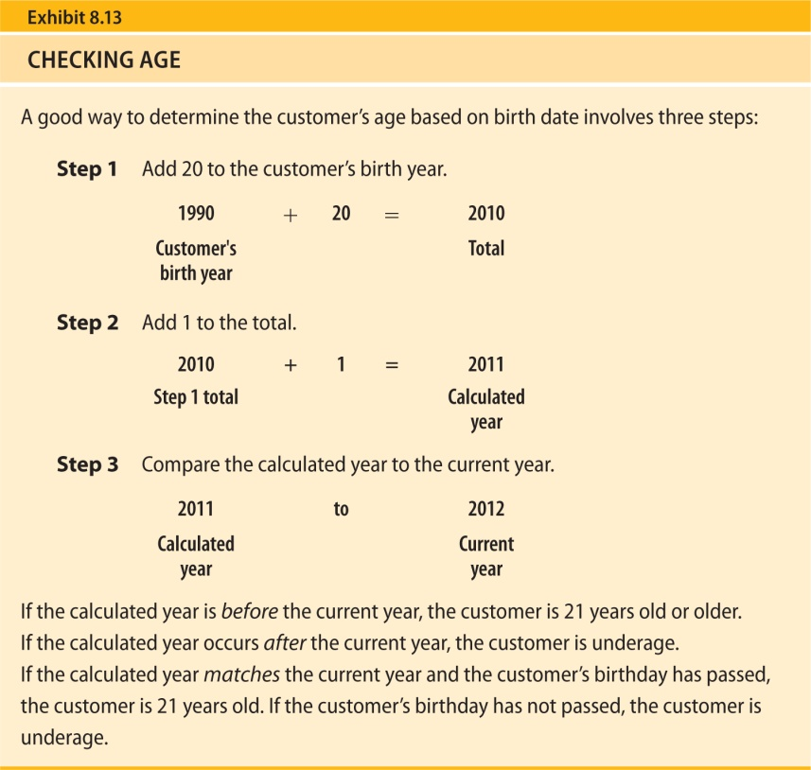
Signs of Intoxication
Preventing Intoxication
Checking Customers’ Identification
Handling Intoxicated Customers
Follow-Up Activities
Training Is Critical

Slide 14
1. Explain how effective managers plan ways to incorporate a nutrition emphasis into their menus and food-preparation procedures.
Nutrition concerns are a long-term trend that must be addressed.
The best managers consider nutrition alternatives when menus are planned and find ways to make simple recipe changes to accommodate nutrition-conscious diners.
Managers can determine the approximate nutritional content for portions produced by standardized recipes.
They do so by developing a nutrition worksheet and using special recipe software to estimate caloric, cholesterol, total fat, sodium, and other desired nutritional information based on ingredients.

Slide 15
2. Review examples of truth-in-menu concerns that must be addressed when menu descriptions are written.
Truth-in-menu laws in many locations require that menu descriptions be honest and selling prices and service charges be accurate.
Examples of information that should be carefully described include preparation style, ingredients, item size, and health claims.

Slide 16
3. Describe elements in an organized system for ensuring the health of customers with food allergies.
There is no known cure for food allergies, and the only way to prevent a potentially fatal reaction is to avoid even trace amounts of the offending food.
Customers with food allergies rely on accurate menu descriptions and information from employees to learn about the ingredients in menu items they select.
Most allergic reactions are caused by peanuts, tree nuts, fish and shellfish, milk, eggs, soy, and wheat.
Managers must train employees in an organized, written plan that indicates who will answer customers’ questions and who will check menu item ingredients.

Slide 17
3. Describe elements in an organized system for ensuring the health of customers with food allergies continued…
Kitchen employees should use care to prevent food from contacting other food items that cause allergies.
Staff must recognize and know what to do if a customer has an allergic reaction.
This system involves close teamwork between managers, servers, and food-preparation staff.

Slide 18
4. Explain concerns about the service of alcoholic beverages.
Laws regulating the sale of alcoholic beverages are developed by states and local communities, but serving alcohol to someone under 21 or someone who appears to be intoxicated is illegal in all states.
Persons with a BAC of 0.08 or higher cannot drive a vehicle.
Factors that affect how high and quickly a customer’s BAC rises include the amount of alcohol consumed, body type, gender, age, emotional state, medications, whether food has been consumed, and a drink’s carbonation.
Counting the number of drinks in comparison to approximate weight can provide a rough idea about a person’s BAC.
Signs of intoxication include relaxed inhibitions, impaired judgment, slowed reaction time, and impaired motor coordination.

Slide 19
4. Explain concerns about the service of alcoholic beverages…
Checking customers’ identification is important, and employees must be trained to tell if an ID is genuine and if a customer is at least 21.
Before stopping alcoholic beverage service, a backup employee should be alerted, and it may be possible to enlist the help of other customers.
When another drink is ordered, the customer should be informed that service will be stopped.
If an intoxicated customer attempts to drive away, car keys should be requested.
If the customer drives away, the police should be contacted.
The same rules apply to a customer who arrives intoxicated.

Slide 20
Key Terms:
Anaphylaxis A potentially life-threatening allergic reaction that can cause a drop in blood pressure, loss of consciousness, and even death.
Blood alcohol content (BAC) The amount of alcohol absorbed into a person’s bloodstream.
Cross-contact A situation that occurs when one food comes into contact with another and their proteins mix.
Food allergy An allergy that occurs when the body mistakes an ingredient in food, usually a protein, as harmful and creates a defense system (antibodies) to fight it.
Nutrition The science of food and how it affects the health and well-being of the person who consumes it.

Slide 21
Key Terms continued:
Proof A measure of liquor strength that represents the percentage of alcohol in the beverage. Percentage is determined by dividing the liquor’s proof by 2 (e.g., a 100-proof whiskey is 50 percent alcohol).
Punitive damages A monetary amount that may be assessed if a court finds an establishment’s actions showed reckless disregard for a customer’s safety. Punitive damages often exceed the amount of compensatory damages.
Truth-in-menu laws Laws in many locations that require menu descriptions to be honest and accurate.

Slide 22
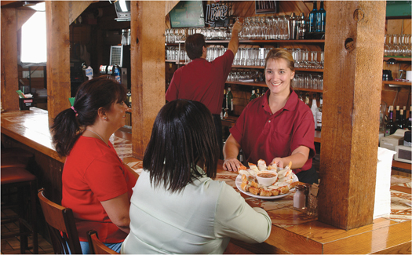
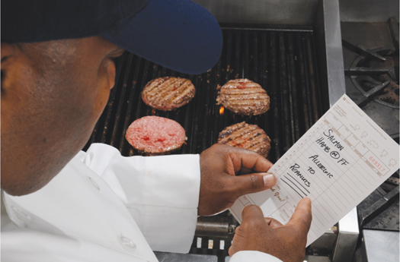
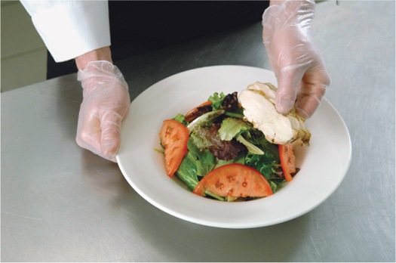
Chapter Images

Slide 23
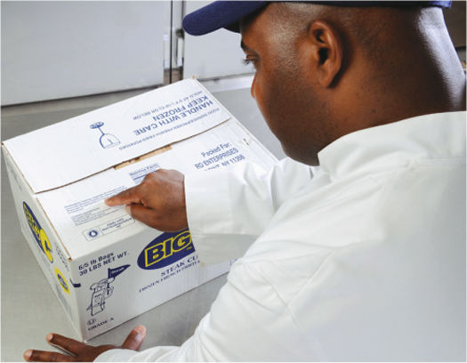
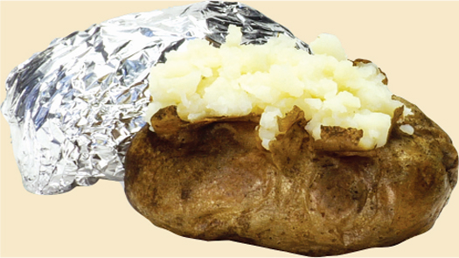
Chapter Images continued

