Slide 1
Notes:
Pearson – Always Learning

Slide 2
What's New in MasteringEngineering
Learning Catalytics Gradebook Sync
Mobile Support and Equation Editor Enhancements
New Simple Editor
Notes:
List of enhancements to Mastering coming with the June release

Slide 3
Learning Catalytics Gradebook Sync
1
Notes:
For Mastering instructors using Learning Catalytics with their students, grades from these sessions will now sync with the Mastering gradebook.

Slide 4
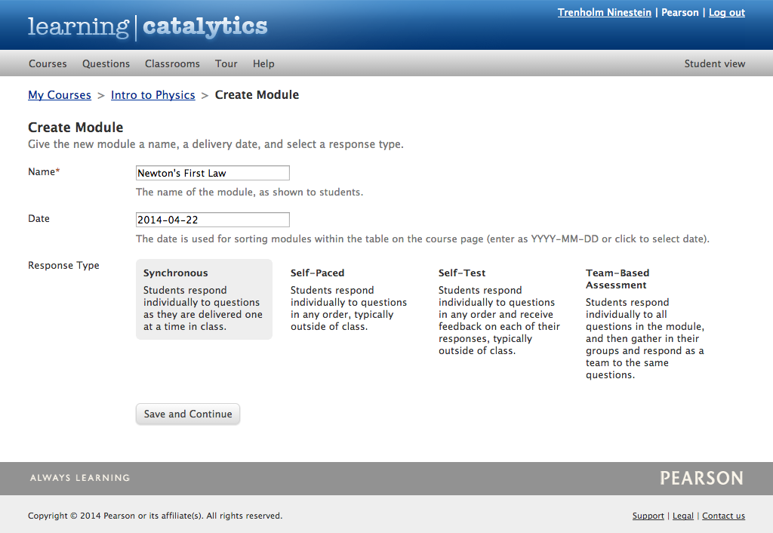
Learning Catalytics Gradebook Sync
Instructor view
Course Home to Create Learning Catalytics module
Notes:
Instructors have access to Learning Catalytics from the Course Home page, inside the In-Class Learning pod.

Slide 5
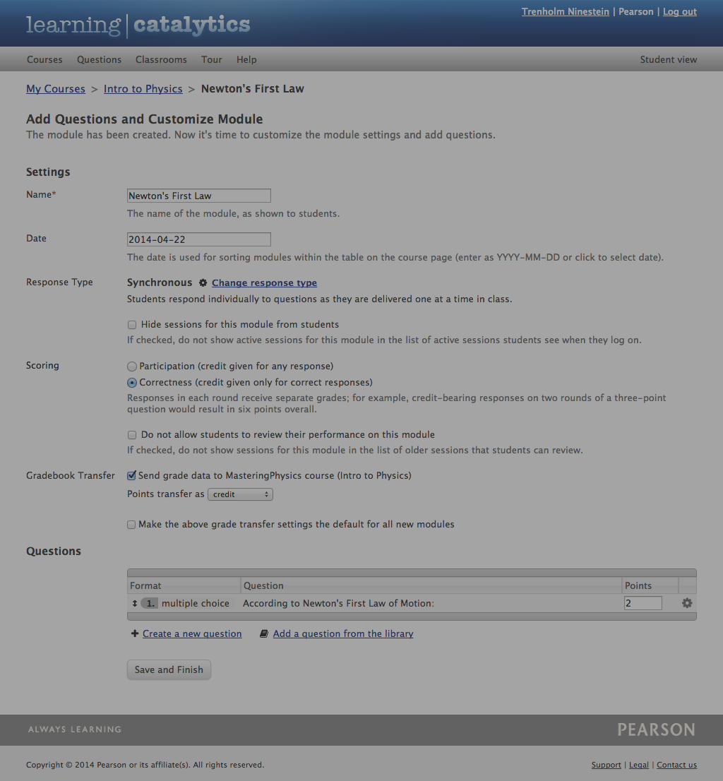
Learning Catalytics Gradebook Sync
Instructor view
Add questions and Customize Module
Module settings
Scoring
(weight participation & correctness)
Gradebook Transfer (points as credit or extra credit)
Assign points per question
Notes:
Instructors can modify the learning modules by specifying the grade settings, electing for grade transfer to the Mastering gradebook, and/or changing the number of points assigned per question. Instructors can also weight both participation and correctness in scoring for synchronous, self-paced, and self-test modules.

Slide 6
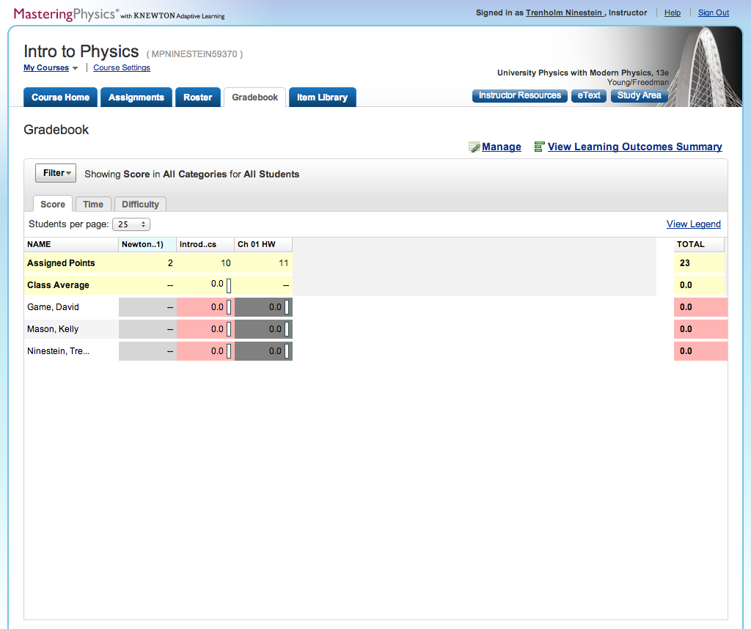
Learning Catalytics Gradebook Sync
Instructor view
Start session in Learning Catalytics; see grades in Mastering gradebook when session ends
Notes:
Instructors must start a session in Learning Catalytics to enable students to join and participate. The column with the blue heading indicates Learning Catalytics’ scores.

Slide 7
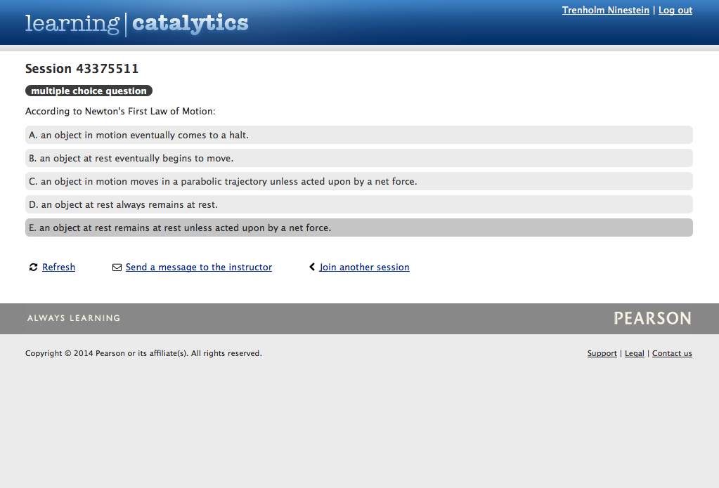
Learning Catalytics Gradebook Sync
Desktop Student view
Notes:
When a Mastering instructor has started a session, the In-Class Learning message box on the student’s Course Home page notifies the student that there are active Learning Catalytics sessions to join.

Slide 8
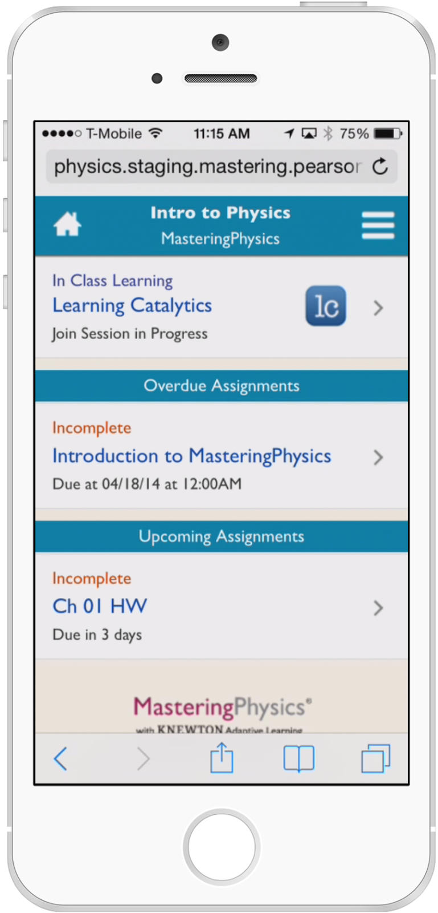
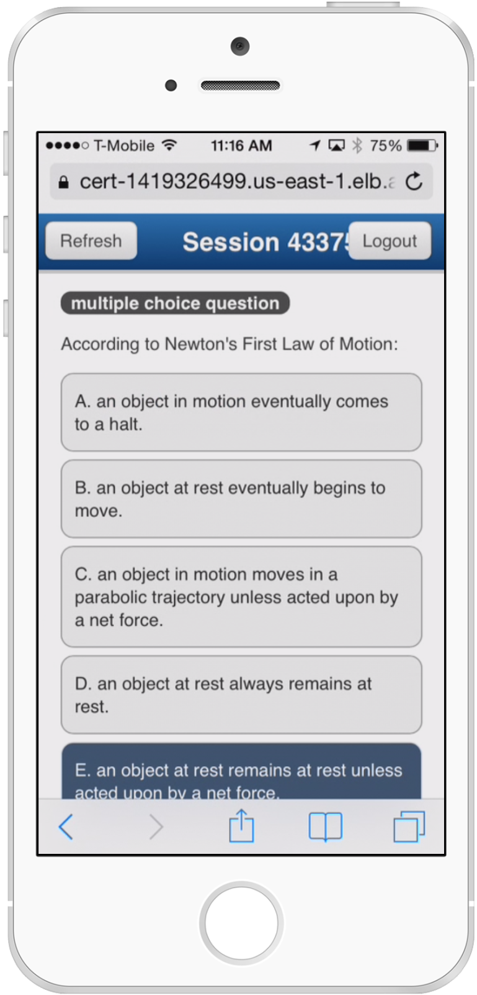
Learning Catalytics Gradebook Sync
Mobile Student view
Notes:
Students can also join sessions from their smartphone.

Slide 9
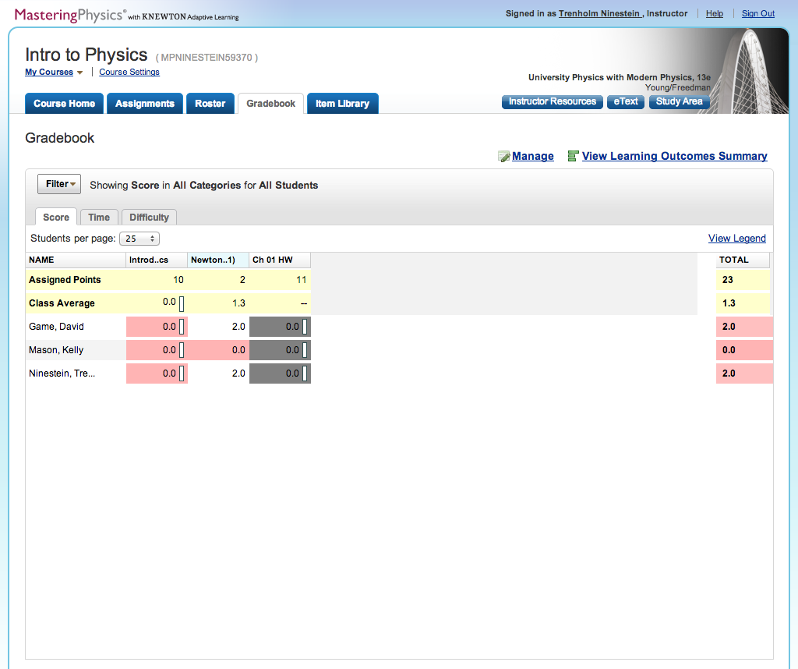
Learning Catalytics Gradebook Sync
Instructor view
Click Stop Session in Learning Catalytics to send grades to Mastering
Notes:
When the instructor selects Stop Session in Learning Catalytics, student grades from this session will automatically be sent to the Mastering gradebook (and any LMS integrated gradebooks, such as Blackboard).

Slide 10
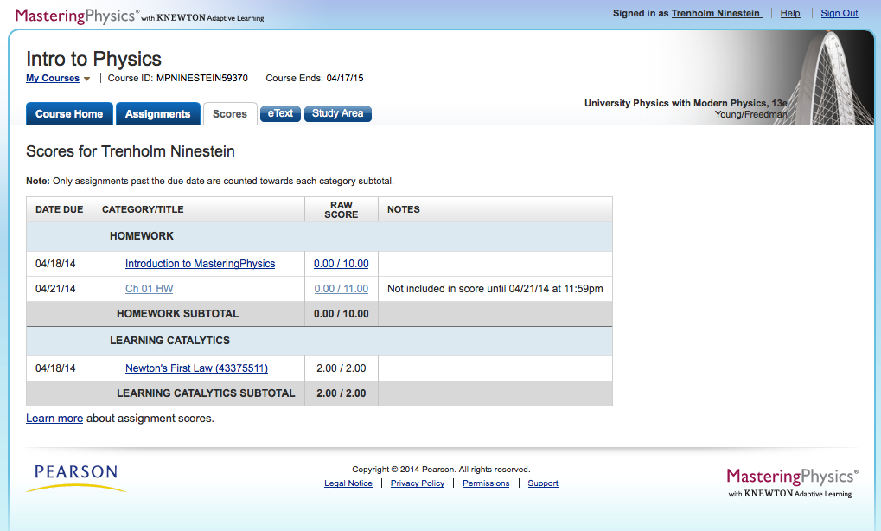
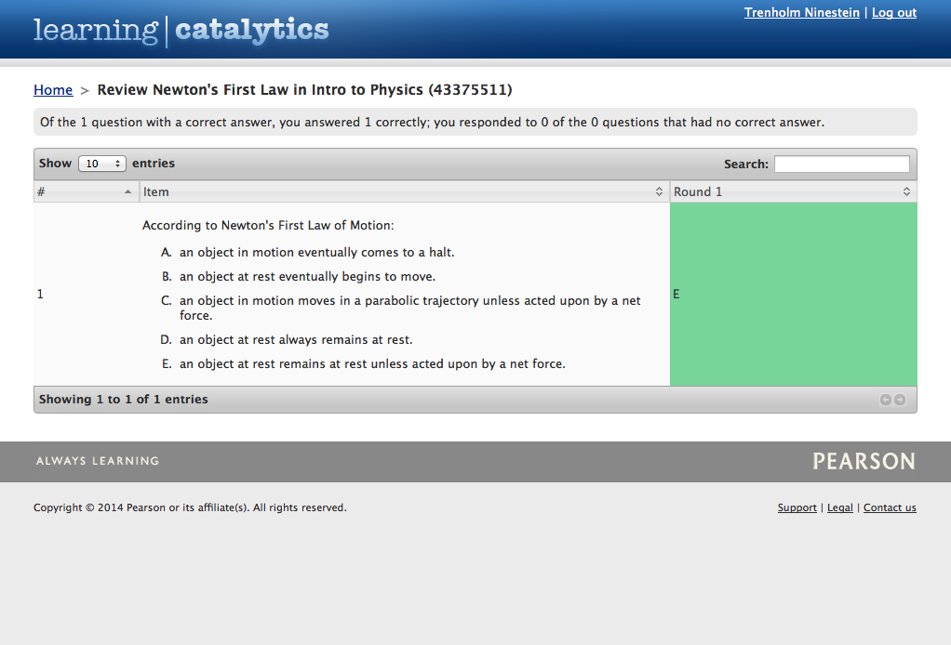
Learning Catalytics Gradebook Sync
Student view
Link directly to review mode in Learning Catalytics from the Scores page
Notes:
These Mastering gradebook scores also link back to the assignment reviews in Learning Catalytics.

Slide 11
Mobile Support & Equation Editor Enhancements
2
Notes:
Disciplines like Engineering, Physics and Chemistry often require questions with answer types that contain a chemical equation or expression. The Equation Editor enables students to enter this type of keyboard-based answer.

Slide 12
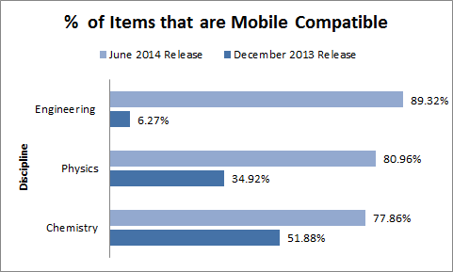
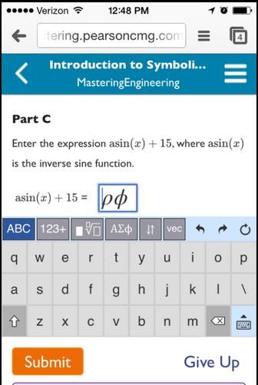
Increased Mobile Compatibility
Notes:
Mastering’s mobile capabilities now include the ability to express answer types like solution symbolic, chemical formula and numbers with units.

Slide 13
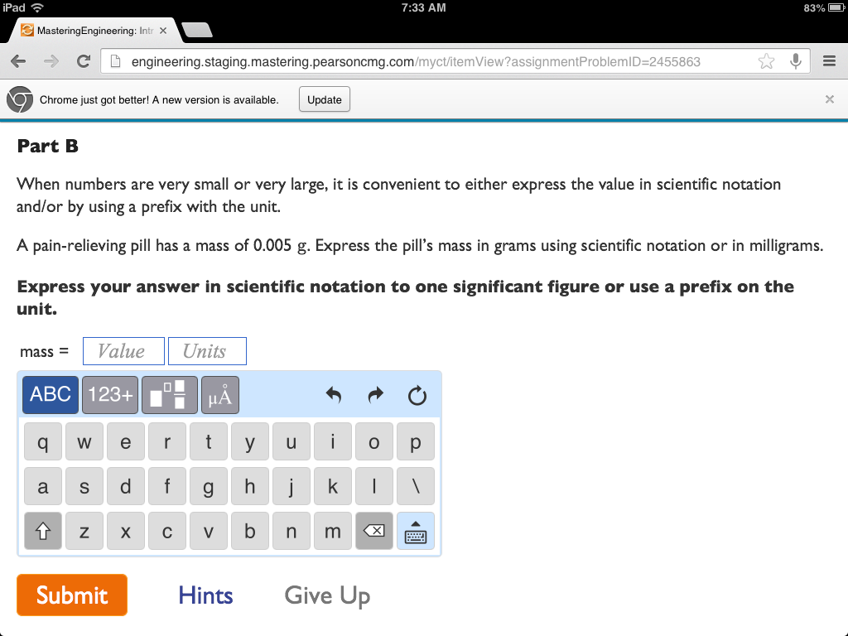
Equation Editor - New Look and Mobile Compatible
Notes:
Our June release includes a mobile optimized version of the Equation Editor for student use. This version is supported on iOS and Android devices, and can be used in any browser normally supported by Mastering products.

Slide 14
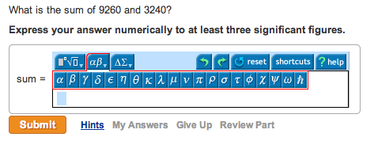
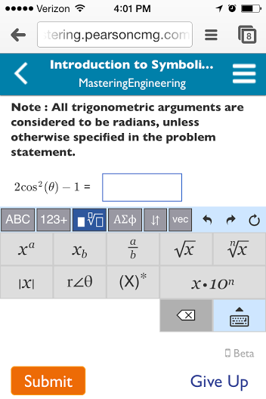
Enhanced Math Palette Design
Old (Flash) version New (HTML5) version
Notes:
The new design includes the addition of the Qwerty and numeric palette keyboards and is also available for the desktop version of the Equation Editor. A Beta version will be released in June and an updated version is expected in late July 2014.

Slide 15
New Simple Editor
3
Notes:
The Simple Editor enables instructors to create and edit assignable content.

Slide 16
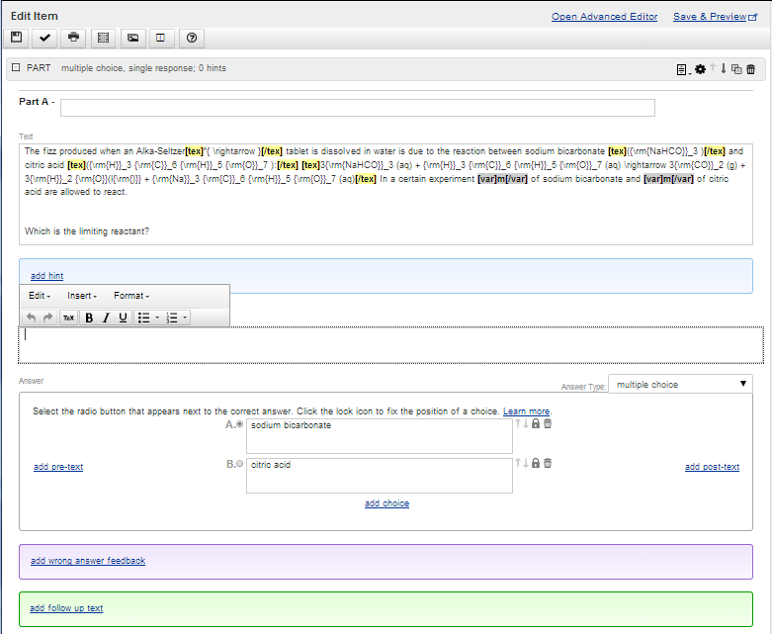
Ease of Use
Single view editing
Inline WYSIWYG editor
Greater browser compatibility
Notes:
Our June release introduces a new Simple Editor, with greater browser supportability, increased answer types and an improved user interface.

Slide 17
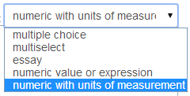
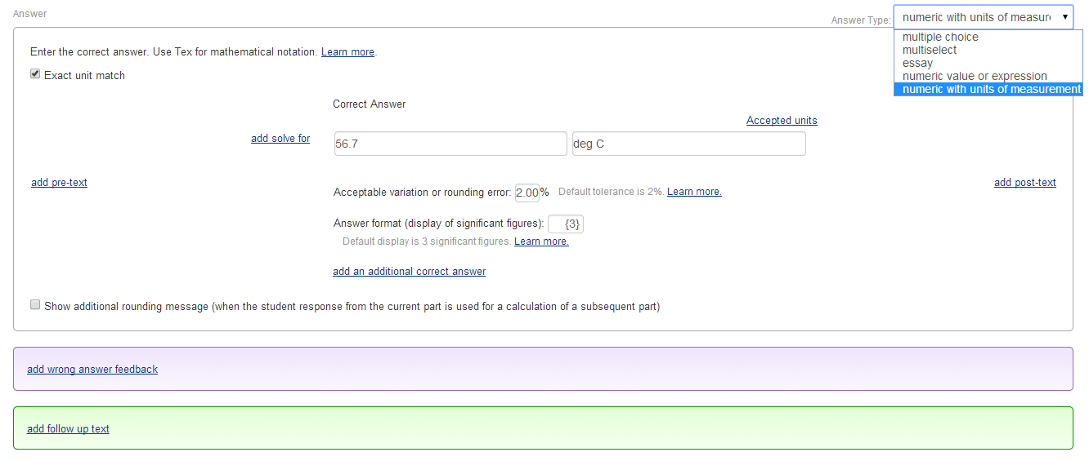
Additional Answer Types
Increases the percentage of items editable by Simple Editor from ~60% to ~90%
Multiple Choice
MultiSelect
Essay
Numeric Value/Expression
- single or multiple term
Number with Units
Notes:
Instructors can now use the Simple Editor to create and edit symbolic, symbolic set (now called numeric value/expression) and number with units answer types in addition to multiple choice, multi-select and essay.

